Slide 1
TRANSACTION MANAGEMENT
BSC. INTERNET OF THINGS – RELATIONAL DATABASES

Slide 2
SERIALIZABILITY
OBJECTIVE OF A CONCURRENCY CONTROL PROTOCOL IS TO SCHEDULE TRANSACTIONS IN SUCH A WAY AS TO AVOID ANY INTERFERENCE.
COULD RUN TRANSACTIONS SERIALLY, BUT THIS LIMITS DEGREE OF CONCURRENCY OR PARALLELISM IN SYSTEM.
THE GOAL OF SERIALIZABILITY IS TO ALLOW TRANSACTIONS TO RUN CONCURRENTLY WHILE STILL HAVING THE SAME RESULTS AS IF THEY WERE RUN SEQUENTIALLY (I.E. SEPARATELY, ONE AFTER THE OTHER)
Pearson Education © 2009

Slide 3
CONCURRENCY CONTROL TECHNIQUES
  TWO BASIC CONCURRENCY CONTROL TECHNIQUES ARE:
    LOCKING
    TIMESTAMPING
  BOTH ARE CONSERVATIVE (PESSIMISTIC) APPROACHES: DELAY TRANSACTIONS IN CASE THEY CONFLICT WITH OTHER TRANSACTIONS.
OPTIMISTIC METHODS ASSUME CONFLICT IS RARE AND ONLY CHECK FOR CONFLICTS AT COMMIT.
  VERSIONING
Pearson Education © 2009

Slide 4
LOCKING
TRANSACTION USES LOCKS TO DENY ACCESS TO OTHER TRANSACTIONS AND SO PREVENT INCORRECT UPDATES.
MOST WIDELY USED APPROACH TO ENSURE SERIALIZABILITY.
GENERALLY, A TRANSACTION MUST CLAIM A SHARED (READ) OR EXCLUSIVE (WRITE) LOCK ON A DATA ITEM BEFORE READ OR WRITE.
LOCK PREVENTS ANOTHER TRANSACTION FROM MODIFYING ITEM OR EVEN READING IT, IN THE CASE OF A WRITE LOCK.
Pearson Education © 2009

Slide 5
LOCKING - BASIC RULES
IF TRANSACTION HAS SHARED LOCK ON ITEM, IT CAN READ BUT NOT UPDATE ITEM.
IF TRANSACTION HAS EXCLUSIVE LOCK ON ITEM, IT CAN BOTH READ AND UPDATE ITEM.
READS CANNOT CONFLICT, SO MORE THAN ONE TRANSACTION CAN HOLD SHARED LOCKS SIMULTANEOUSLY ON SAME ITEM.
EXCLUSIVE LOCK GIVES TRANSACTION EXCLUSIVE ACCESS TO THAT ITEM (I.E. THE ITEM CANNOT EVEN BE READ BY OTHER TRANSACTIONS).
Pearson Education © 2009

Slide 6
LOCKING - BASIC RULES
SOME SYSTEMS ALLOW TRANSACTION TO UPGRADE READ LOCK TO AN EXCLUSIVE LOCK, OR DOWNGRADE EXCLUSIVE LOCK TO A SHARED LOCK.
Pearson Education © 2009

Slide 7
LOCKING
LOCKING DOES NOT ALLOW GUARANTEE SERIALIZABILITY
IN THE EXAMPLE ON THE NEXT SLIDE, IF THE LOCK ON BAL_{X} IS RELEASED BY T9 AS SOON AS THE UPDATE IS COMPLETED, T10 CAN PROCEED TO READ THE VALUE OF BAL_{X}
HOWEVER, THIS COULD CAUSE INCONSISTENCIES IF T9 WAS LATER ROLLED BACK INSTEAD OF COMMITTED

Slide 8
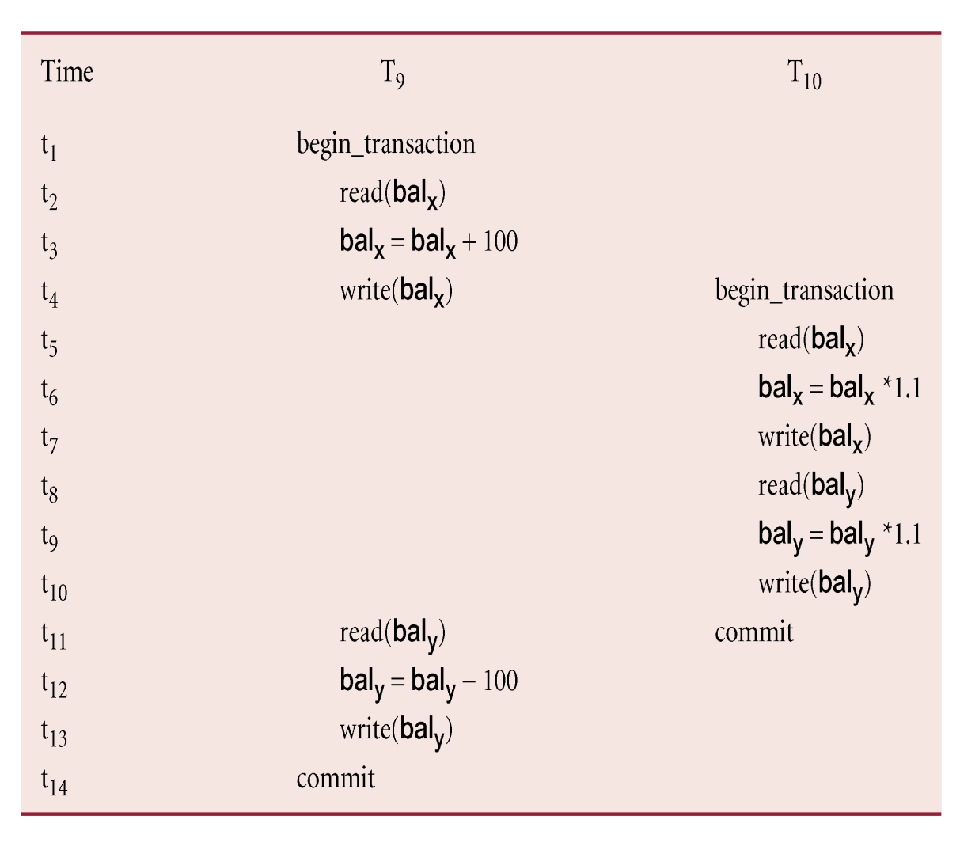
EXAMPLE
Pearson Education © 2009

Slide 9
TWO-PHASE LOCKING (2PL)
TRANSACTION FOLLOWS 2PL PROTOCOL IF ALL LOCKING OPERATIONS PRECEDE FIRST UNLOCK OPERATION IN THE TRANSACTION.
  IN OTHER WORDS, ALL LOCKS ARE HELD UNTIL THE TRANSACTION ENDS (EITHER COMMITTED OR ROLLED BACK)
TWO PHASES FOR TRANSACTION:
  GROWING PHASE - ACQUIRES ALL LOCKS BUT CANNOT RELEASE ANY LOCKS.
  SHRINKING PHASE - RELEASES LOCKS BUT CANNOT ACQUIRE ANY NEW LOCKS.
Pearson Education © 2009

Slide 10
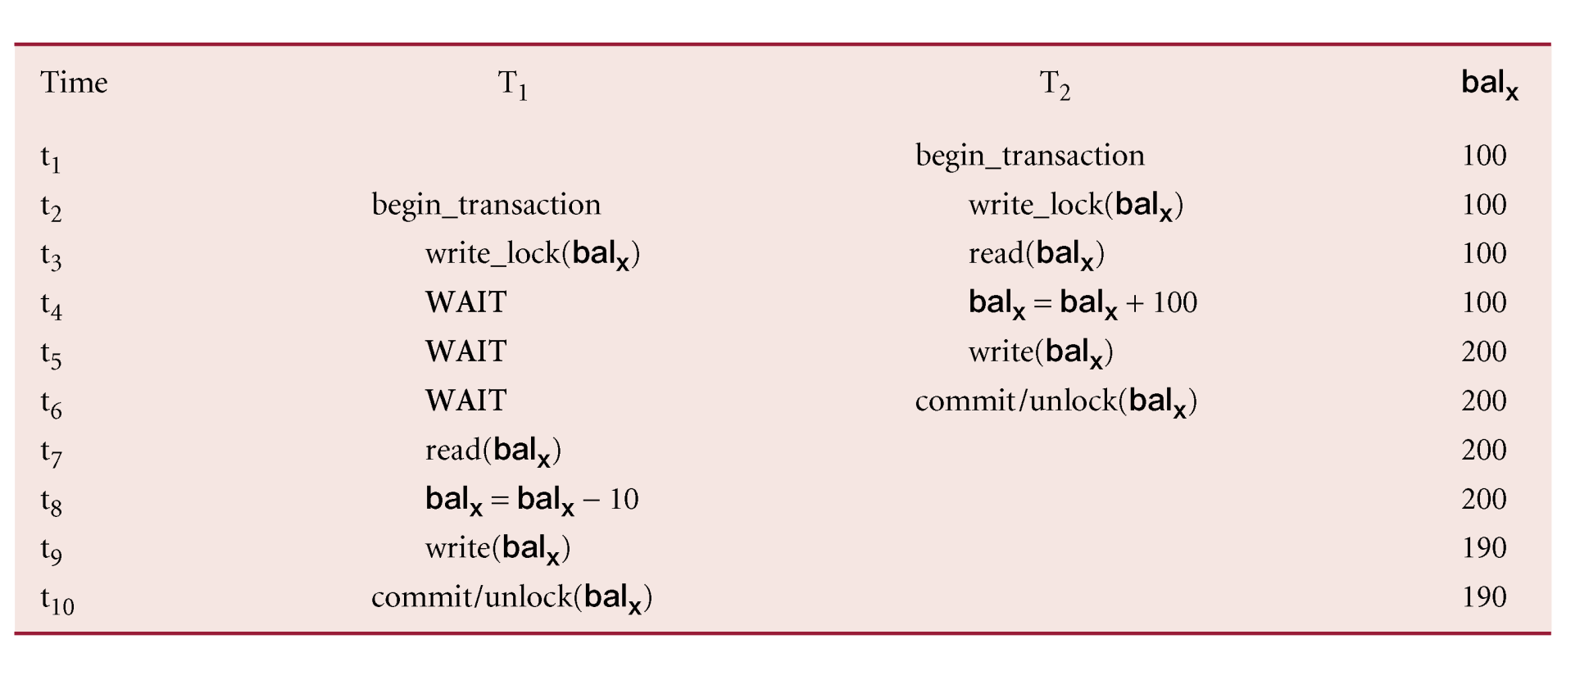
PREVENTING LOST UPDATE PROBLEM USING 2PL
Pearson Education © 2009

Slide 11
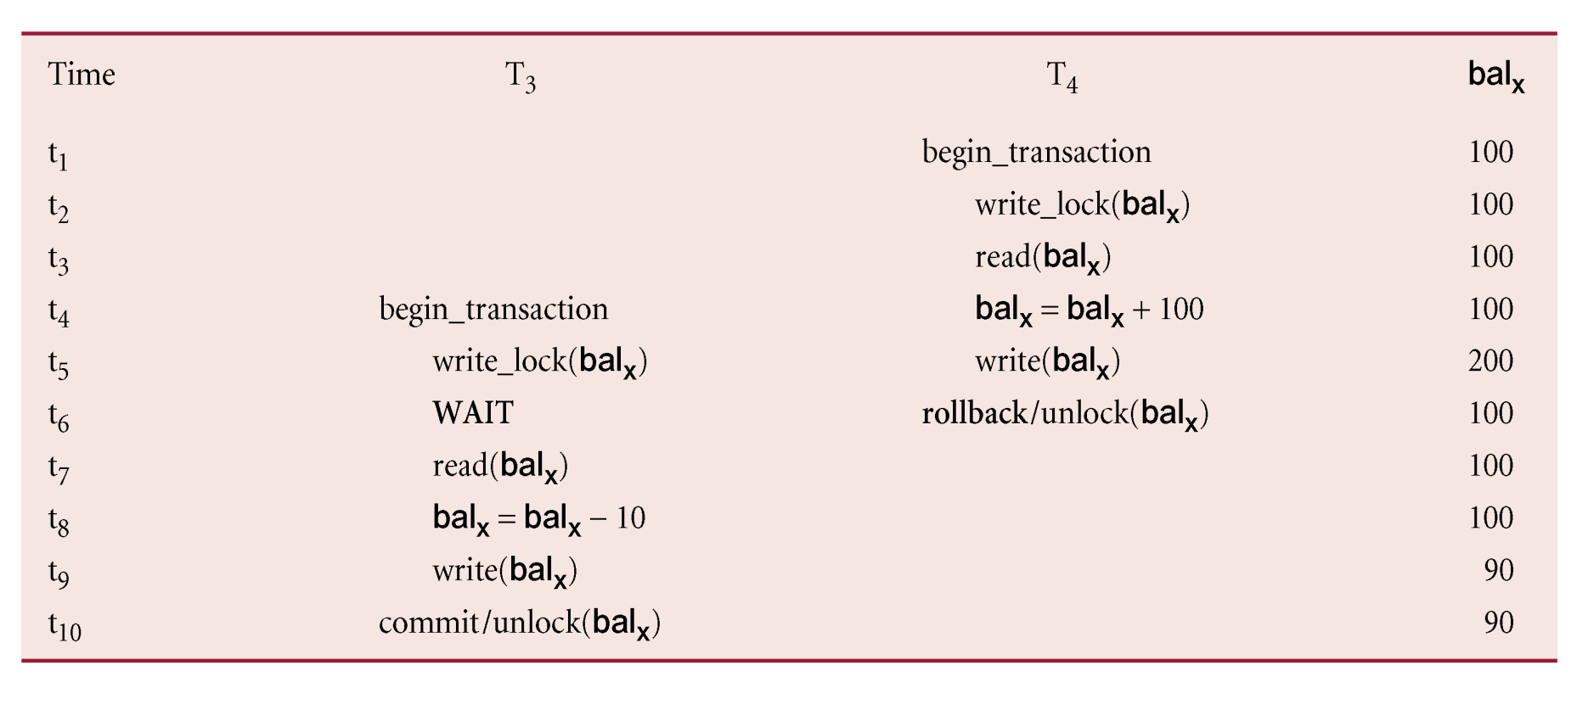
PREVENTING UNCOMMITTED DEPENDENCY PROBLEM USING 2PL
Pearson Education © 2009

Slide 12
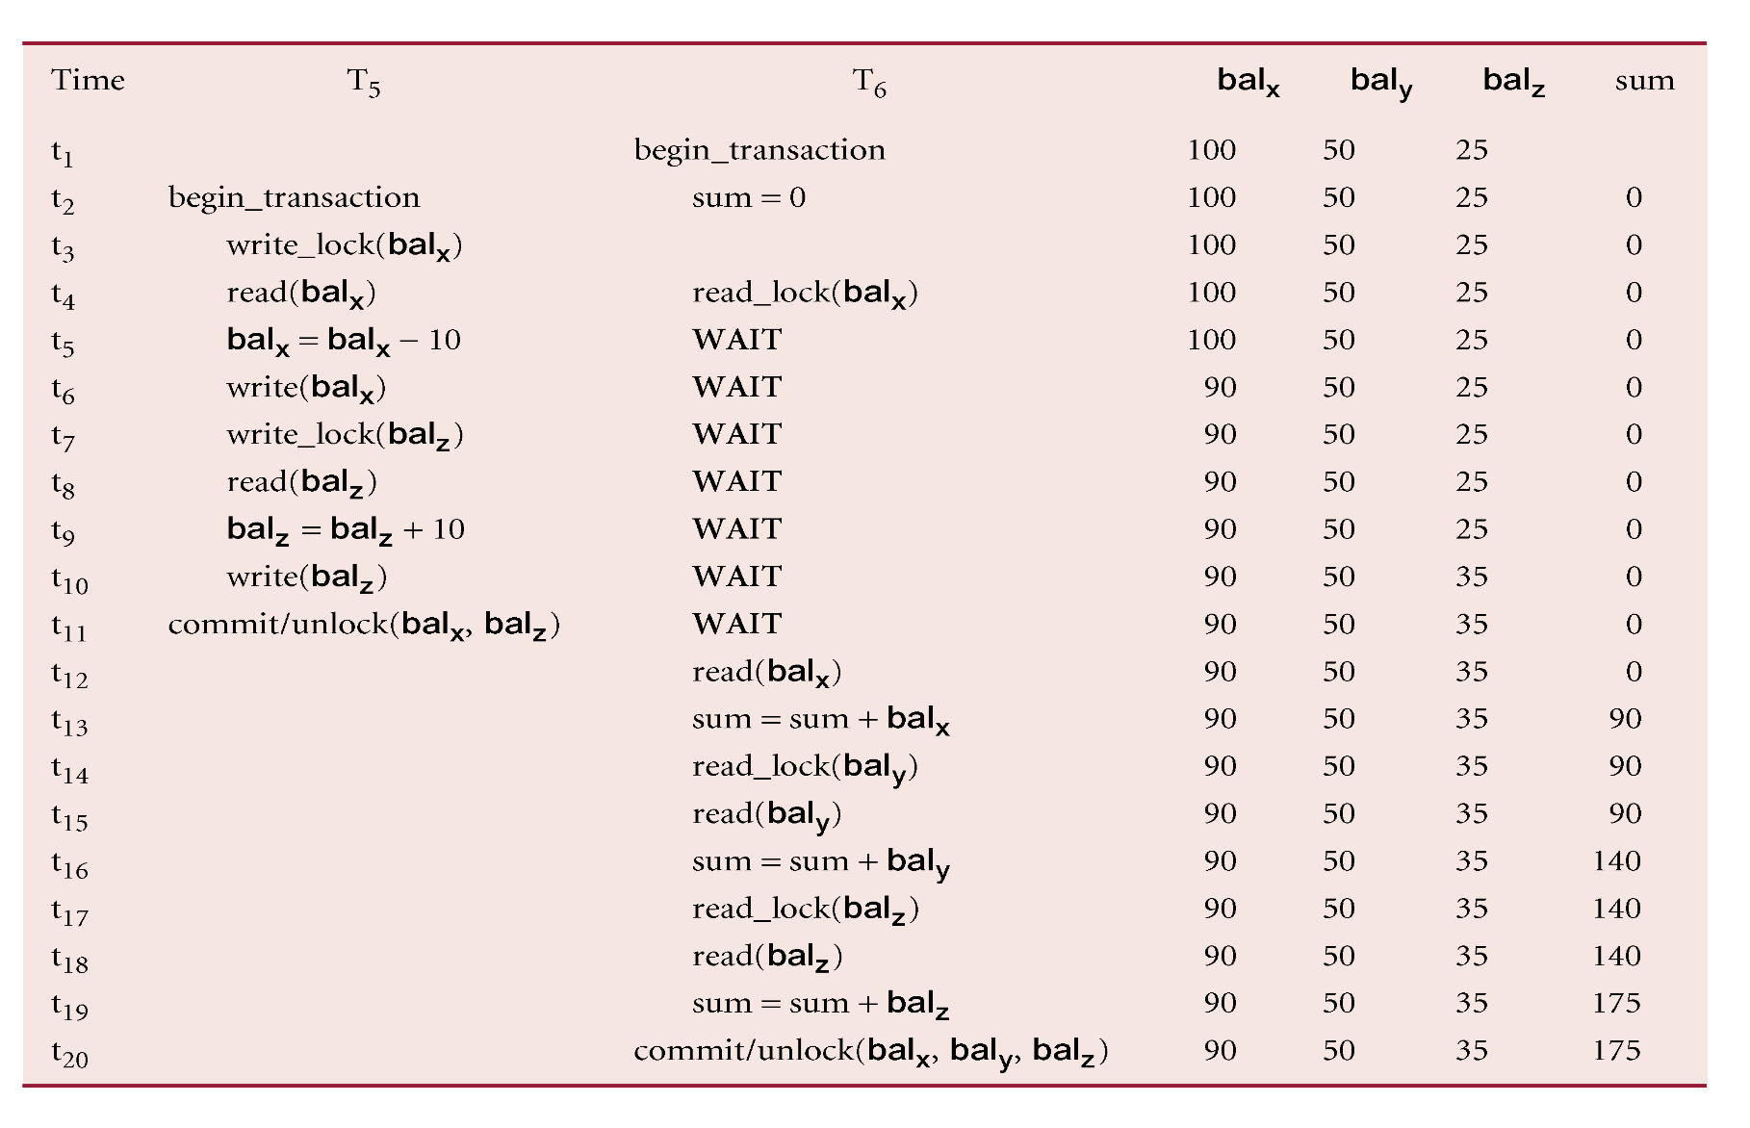
PREVENTING INCONSISTENT ANALYSIS PROBLEM USING 2PL
Pearson Education © 2009

Slide 13
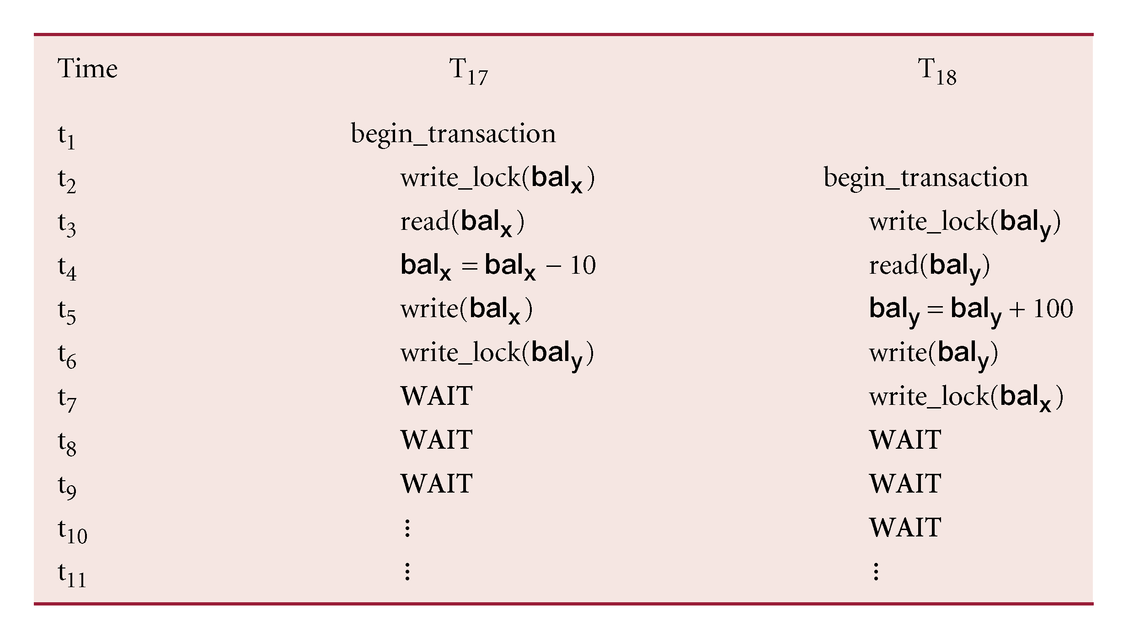
DEADLOCK
AN IMPASSE THAT MAY RESULT WHEN TWO (OR MORE) TRANSACTIONS ARE EACH WAITING FOR LOCKS HELD BY THE OTHER TO BE RELEASED.
Pearson Education © 2009

Slide 14
DEADLOCK
ONLY ONE WAY TO BREAK DEADLOCK: ABORT ONE OR MORE OF THE TRANSACTIONS.
DEADLOCK SHOULD BE TRANSPARENT TO USER, SO DBMS SHOULD RESTART TRANSACTION(S).
THREE GENERAL TECHNIQUES FOR HANDLING DEADLOCK:
  TIMEOUTS.
  DEADLOCK PREVENTION.
  DEADLOCK DETECTION AND RECOVERY.
Pearson Education © 2009

Slide 15
TIMEOUTS
TRANSACTION THAT REQUESTS LOCK WILL ONLY WAIT FOR A SYSTEM-DEFINED PERIOD OF TIME.
IF LOCK HAS NOT BEEN GRANTED WITHIN THIS PERIOD, LOCK REQUEST TIMES OUT.
IN THIS CASE, DBMS ASSUMES TRANSACTION MAY BE DEADLOCKED, EVEN THOUGH IT MAY NOT BE, AND IT ABORTS AND AUTOMATICALLY RESTARTS THE TRANSACTION.
Pearson Education © 2009

Slide 16
DEADLOCK PREVENTION
DBMS LOOKS AHEAD TO SEE IF TRANSACTION WOULD CAUSE DEADLOCK AND NEVER ALLOWS DEADLOCK TO OCCUR.
COULD ORDER TRANSACTIONS USING TRANSACTION TIMESTAMPS:
  WAIT-DIE: ONLY AN OLDER TRANSACTION CAN WAIT FOR YOUNGER ONE, OTHERWISE TRANSACTION IS ABORTED (DIES) AND RESTARTED WITH SAME TIMESTAMP.
  WOUND-WAIT: ONLY A YOUNGER TRANSACTION CAN WAIT FOR AN OLDER ONE. IF OLDER TRANSACTION REQUESTS LOCK HELD BY YOUNGER ONE, YOUNGER ONE IS ABORTED (WOUNDED).
Pearson Education © 2009

Slide 17
WAIT-DIE VS. WOUND-WAIT
 | Wait-Die | Wound-Wait
O needs resource held by Y | O waits | Y dies
Y needs resource held by O | Y dies | Y waits
O = Older transaction
Y = Younger transaction

Slide 18
DEADLOCK DETECTION AND RECOVERY
DBMS ALLOWS DEADLOCK TO OCCUR BUT RECOGNIZES IT AND BREAKS IT.
USUALLY HANDLED BY CONSTRUCTION OF WAIT-FOR GRAPH (WFG) SHOWING TRANSACTION DEPENDENCIES:
  CREATE A NODE FOR EACH TRANSACTION.
  CREATE EDGE TI -> TJ, IF TI WAITING TO LOCK ITEM LOCKED BY TJ.
DEADLOCK EXISTS IF AND ONLY IF WFG CONTAINS CYCLE.
WFG IS CREATED AT REGULAR INTERVALS.
Pearson Education © 2009

Slide 19
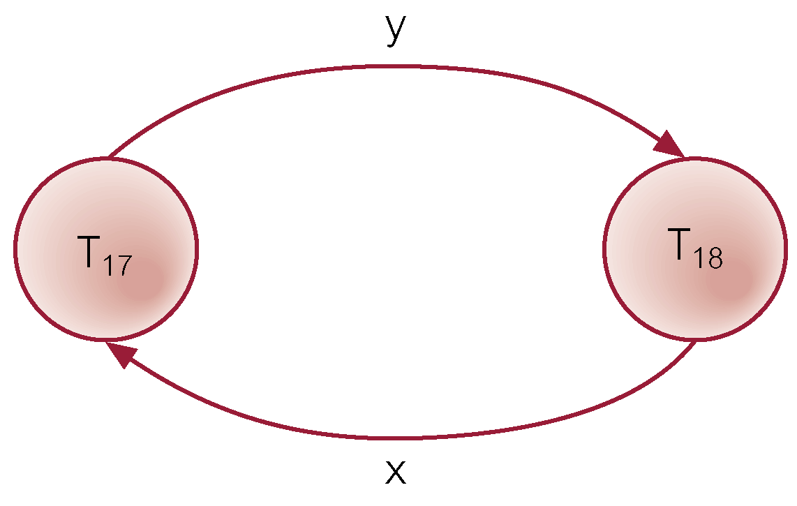
EXAMPLE - WAIT-FOR-GRAPH (WFG)
Pearson Education © 2009

Slide 20
RECOVERY FROM DEADLOCK DETECTION
SEVERAL ISSUES:
  CHOICE OF DEADLOCK VICTIM;
  HOW FAR TO ROLL A TRANSACTION BACK;
  AVOIDING STARVATION.
Pearson Education © 2009

Slide 21
TIMESTAMPING
TRANSACTIONS ORDERED GLOBALLY SO THAT OLDER TRANSACTIONS, TRANSACTIONS WITH SMALLER TIMESTAMPS, GET PRIORITY IN THE EVENT OF CONFLICT.
CONFLICT IS RESOLVED BY ROLLING BACK AND RESTARTING TRANSACTION.
NO LOCKS SO NO DEADLOCK.
Pearson Education © 2009

Slide 22
TIMESTAMPING
TIMESTAMP
  A UNIQUE IDENTIFIER CREATED BY DBMS THAT INDICATES RELATIVE STARTING TIME OF A TRANSACTION.
CAN BE GENERATED BY USING SYSTEM CLOCK AT TIME TRANSACTION STARTED, OR BY INCREMENTING A LOGICAL COUNTER EVERY TIME A NEW TRANSACTION STARTS.
Pearson Education © 2009

Slide 23
TIMESTAMPING
READ/WRITE PROCEEDS ONLY IF LAST READ/WRITE ON THAT DATA ITEM WAS CARRIED OUT BY AN OLDER TRANSACTION.
OTHERWISE, TRANSACTION REQUESTING READ/WRITE IS RESTARTED AND GIVEN A NEW TIMESTAMP.
ALSO TIMESTAMPS FOR DATA ITEMS:
  READ-TIMESTAMP - TIMESTAMP OF LAST TRANSACTION TO READ ITEM;
  WRITE-TIMESTAMP - TIMESTAMP OF LAST TRANSACTION TO WRITE ITEM.
Pearson Education © 2009

Slide 24
TIMESTAMPING EXAMPLE
John | Time | Marsha | Bal_{x} | Data Item Timestamp
read (bal_{x}) | t1 |  | 100 | Last read by John at t1
 | t2 | read (bal_{x}) | 100 | Last read by Marsha at t2
bal_{x} = bal_{x} - 50 | t3 |  | 50
write (bal_{x}) * | t4 |  | 50
roll back | t5 | bal_{x} = bal_{x} – 10 | 90
 | t6 | write (bal_{x}) | 90 | Last updated by Marsha at t6
read (bal_{x}) | t7 |  | 90 | Last read by John at t7
 | t8 |  | 90
bal_{x} = bal_{x} - 50 | t9 |  | 40
write (bal_{x}) ** | t10 |  | 40 | Last update by John at t10
 | t11
 | t12

Slide 25
TIMESTAMPING EXAMPLE
  * PROBLEM OCCURS HERE – JOHN HAS TRIED TO UPDATE A DATA ITEM WHICH WAS LAST READ BY ANOTHER TRANSACTION (MARSHA). THEREFORE HIS TRANSACTION MUST BE ROLLED BACK - ABORTED AND RESTARTED, AND GIVEN A NEW TIMESTAMP. FROM TIME T6 AND ONWARDS MARSHA IS NOW THE OLDER TRANSACTION, WHEREAS JOHN’S TRANSACTION IS THE NEWER OF THE TWO (HAVING BEEN GIVEN A NEW TIMESTAMP).
  ** THIS TIME JOHN’S UPDATE TO THE BALANCE IS ALLOWED TO PROCEED, AS THE DATA ITEM HAS NOT BEEN READ/UPDATED BY ANYONE ELSE SINCE HIS TRANSACTION WAS RESTARTED.

Slide 26
OPTIMISTIC TECHNIQUES
BASED ON ASSUMPTION THAT CONFLICT IS RARE AND MORE EFFICIENT TO LET TRANSACTIONS PROCEED WITHOUT DELAYS TO ENSURE SERIALIZABILITY.
AT COMMIT, CHECK IS MADE TO DETERMINE WHETHER CONFLICT HAS OCCURRED.
IF THERE IS A CONFLICT, TRANSACTION MUST BE ROLLED BACK AND RESTARTED.
POTENTIALLY ALLOWS GREATER CONCURRENCY THAN TRADITIONAL PROTOCOLS.
Pearson Education © 2009

Slide 27
VERSIONING
VERSIONING OF DATA CAN BE USED TO INCREASE CONCURRENCY.
BASIC TIMESTAMP ORDERING PROTOCOL ASSUMES ONLY ONE VERSION OF DATA ITEM EXISTS, AND SO ONLY ONE TRANSACTION CAN ACCESS DATA ITEM AT A TIME.
CAN ALLOW MULTIPLE TRANSACTIONS TO READ AND WRITE DIFFERENT VERSIONS OF SAME DATA ITEM.
IN MULTIVERSION CONCURRENCY CONTROL, EACH WRITE OPERATION CREATES NEW VERSION OF DATA ITEM WHILE RETAINING OLD VERSION.
NEW VERSIONS ARE LATER MERGED INTO THE DATABASE; CONFLICTS ARE DEALT WITH IF THEY ARISE
Pearson Education © 2009

Slide 28
GRANULARITY OF DATA ITEMS
SIZE OF DATA ITEMS CHOSEN AS UNIT OF PROTECTION BY CONCURRENCY CONTROL PROTOCOL.
RANGING FROM COARSE TO FINE:
  THE ENTIRE DATABASE.
  A FILE.
  A PAGE (OR AREA OR DATABASE SPACED).
  A RECORD.
  A FIELD VALUE OF A RECORD.
Pearson Education © 2009

Slide 29
GRANULARITY OF DATA ITEMS
TRADEOFF:
  COARSER, THE LOWER THE DEGREE OF CONCURRENCY;
  FINER, MORE LOCKING INFORMATION THAT IS NEEDED TO BE STORED.
BEST ITEM SIZE DEPENDS ON THE TYPES OF TRANSACTIONS.
Pearson Education © 2009

